Slide 1
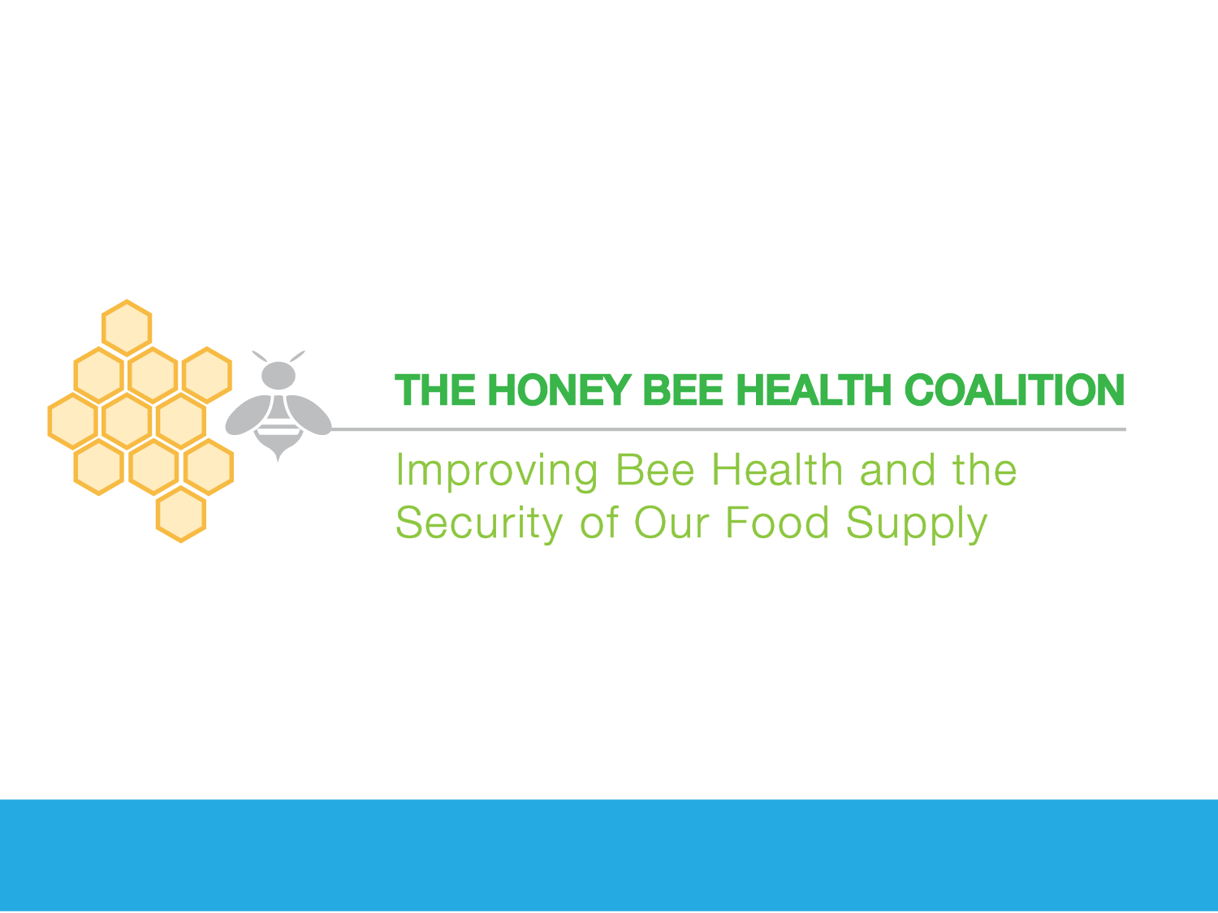
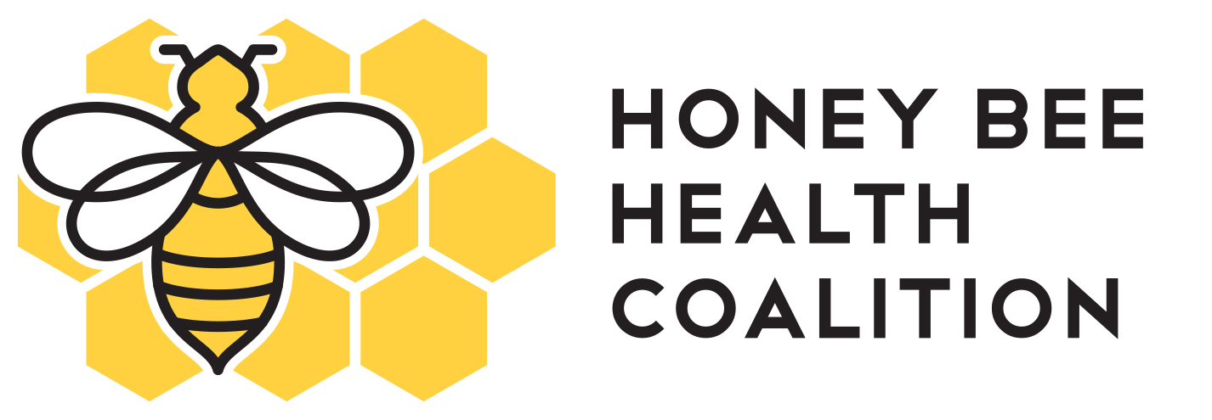
HEALTHY BEES, HEALTHY PEOPLE, HEALTHY PLANET.TM

Slide 2

A diverse, collaborative, private-public partnership addressing the multiple factors impacting honey bees

Slide 3

WHY the Honey Bee Health Coalition?

Slide 4
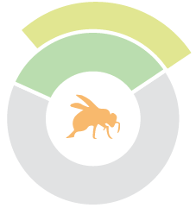





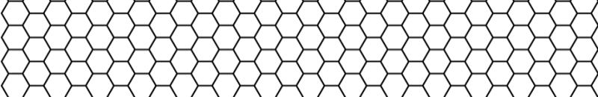
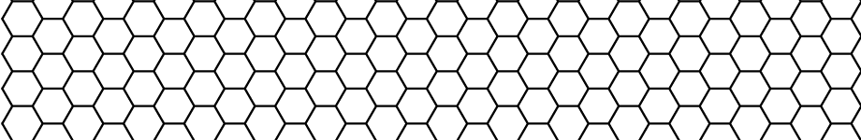


THE WORLD RELIES ON THE HONEY BEE
Honey Bees Are a Key Component to Sustainable Agriculture, Healthy Diets, the Global Food Supply, and the Economy
A Healthy Diet
80%
of flowering plants are pollinated by honey bees and other insects
1/3
of global food production volume relies on pollinators
to some degree
Source: Calderone, 2012
Source: Klein, 2007
Almonds
Apples
Broccoli
Strawberries
Alfalfa
*
*Significant to beef and diary industries as cattle feed
U.S. Agriculture
Canadian Agriculture
$~18
Billion
Per year
$~4 Billion
The amount of dollars of U.S. agricultural production supported by honey bee pollination
The annual value of honey bee pollination in Canada.
Source: USDA
Source: Agriculture and Agri-Food Canada
The future security of America's food supply depends on healthy honey bees Tom Vilsack, Agriculture Secretary

Slide 5


THE CURRENT CHALLENGE
Factors that Pose a Challenge for Honey Bee Health
The Challenge
Stress Factors
Impacts on bee health have been linked to a variety of factors, including those influenced by the activities associated with both beekeeping and crop production.
Lack of Forage & Nutrition
Lack of Genetic Diversity in Breeding
Incidental Pesticide
Exposure
Pests & Disease
Of honey bee population lost each winter, compared to 10-15% historically
APPROX. 29%
Agriculture, healthy lifestyles, and worldwide food security depend on honey bee health. U.S. overwintering losses for managed honey bees between 2006 and 2015 ranged from approximately 23-36%, compared to a historical rate of overwintering losses of 10-15%.*
*Source: Survey data generated by USDA

Slide 6
A SHARED FOOD
VALUE CHAIN
Honey Bees Play a Foundational Role in Our Food Value Chain
MANY STAKEHOLDERS, ONE AGRICULTURE
Producers
Farming
Beekeepers, honey producers, and honey bees
Agribusinesses
Inputs (seeds, fertilizers, crop chemicals, equipment)
Trading
Processing
Consumers
Shopping
Consumption
Manufacturers & Brands
Restaurants
Consumer brands
Retail
Researchers, Government Agencies, & Academia
Research, Education, Extension, Regulation

Slide 7
WHAT’S AT STAKE?
If a diversity of stakeholders do not effectively collaborate on this issue to identify solutions that work, we risk:
A decline in the health of honey bees and other managed and native pollinators
Economic impacts on the beekeeping industry, growers and producers whose crops are pollinated by bees, rural economies, and North American agriculture
Impacts to our global food supply, biodiversity and healthy ecosystems
What’s at Stake?

Slide 8
WHO and WHAT is the Honey Bee Health Coalition?

Slide 9

HONEY BEE HEALTH COALITION MISSION
Collaboratively implement solutions that will help to achieve a healthy population of honey bees while also supporting
healthy populations of native and managed pollinators in the context
of productive agricultural systems and thriving ecosystems.

Slide 10
HONEY BEE HEALTH COALITION MEMBERSHIP
Coalition members work across the full food value chain:
  Beekeepers and Honey Producers
  Crop Producers
  Agribusinesses
  Manufacturers and Brands
  Agencies and Universities
  Conservation Groups and Bee-Focused NGOs

Slide 11


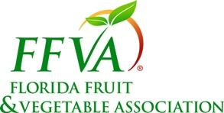


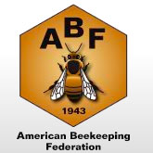











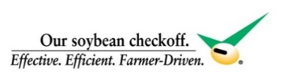


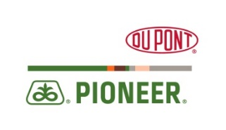


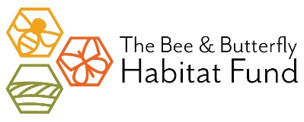

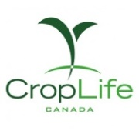

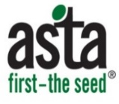




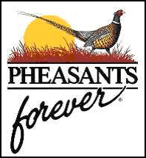
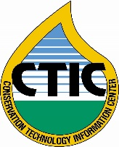
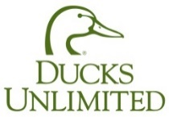
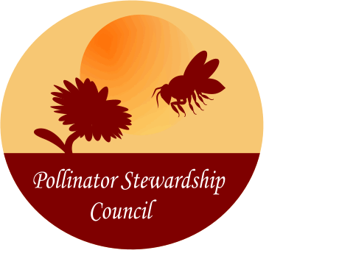


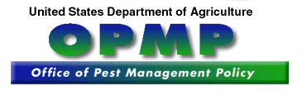



HONEY BEE HEALTH COALITION MEMBERSHIP

Slide 12
HOW THE COALITION OPERATES
Launched during Pollinator Week in June of 2014
Governed by a charter and ground rules
Every member organization has an equal voice in the Coalition’s consensus-based decision-making process.
Member funded; level of financial support does not influence an organization’s role in decision making
Third party, independent facilitation by Keystone Policy Center, a nationally recognized nonprofit
How does the Coalition operate?

Slide 13
WHAT IS THE COALITION?
A collaborative, science-based, cross-sector effort to improve the health of honey bees.
Principles
Cross-sector, collaborative
Recognizes multi-factorial problems
Outcome and solution-oriented
Science-based

Slide 14
WHAT is the Coalition doing?

Slide 15
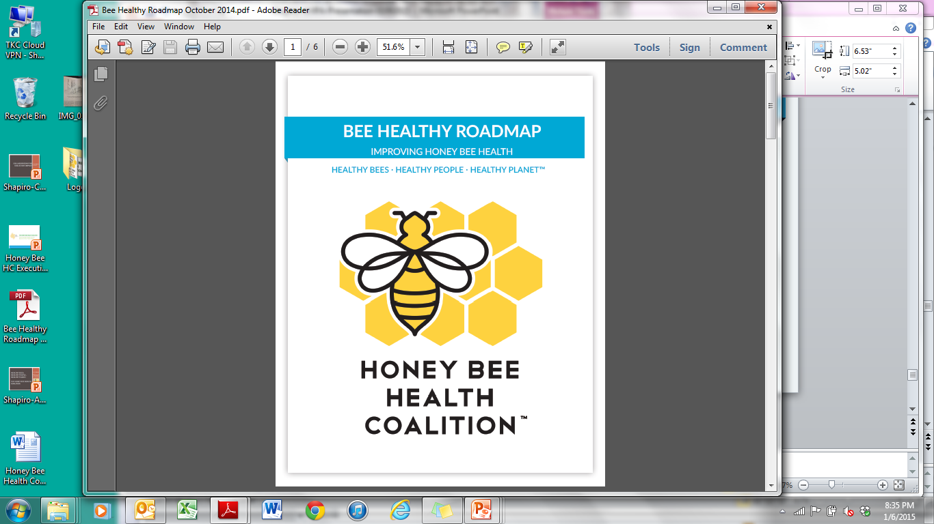
BEE HEALTHY ROADMAP
Shares the Coalition’s mission, vision, and strategic goals
Identifies 4 top priorities that need collective action and collaboration
www.honeybeehealthcoalition.org

Slide 16




HONEY BEE HEALTH COALITION PRIORITIES
The Coalition is focusing on accelerating collective impact to improve honey bee health in four key areas.
Nutrition & Forage
Hive Management
Crop Pest Management
Outreach, Education and Collaboration
Ensure honey bees – especially those in and around production agriculture – have access to a varied and nutritious diet.
Put the best available tools, techniques, and technologies in the hands of beekeepers so they can better manage their hives.
Control crop pests while safeguarding pollinator health.
Work together to improve honey bee health; develop outreach materials; and develop future research and demonstration projects.
34

Slide 17
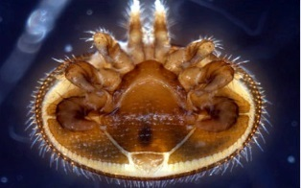
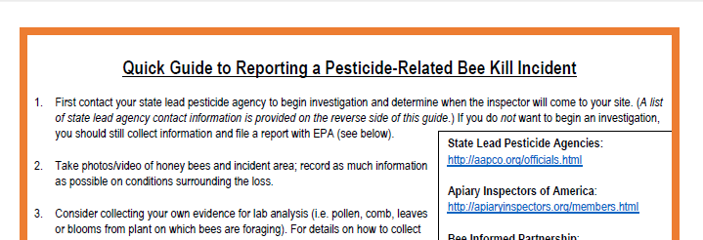
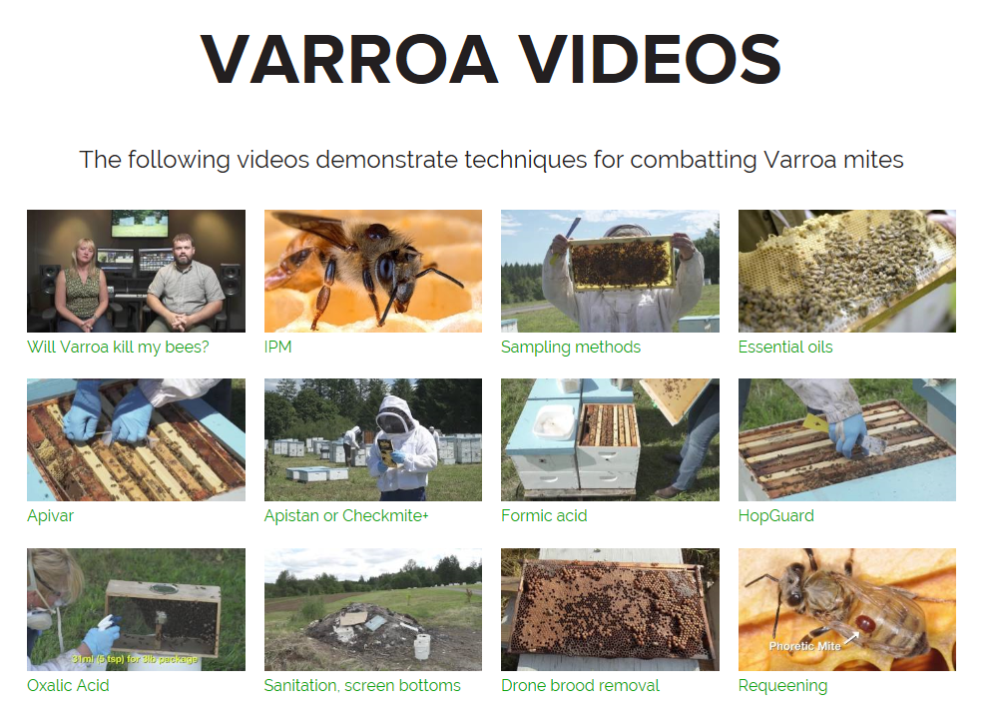
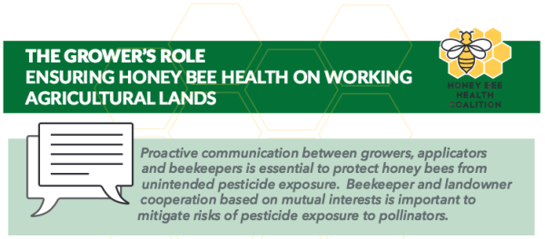
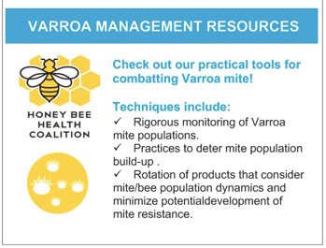
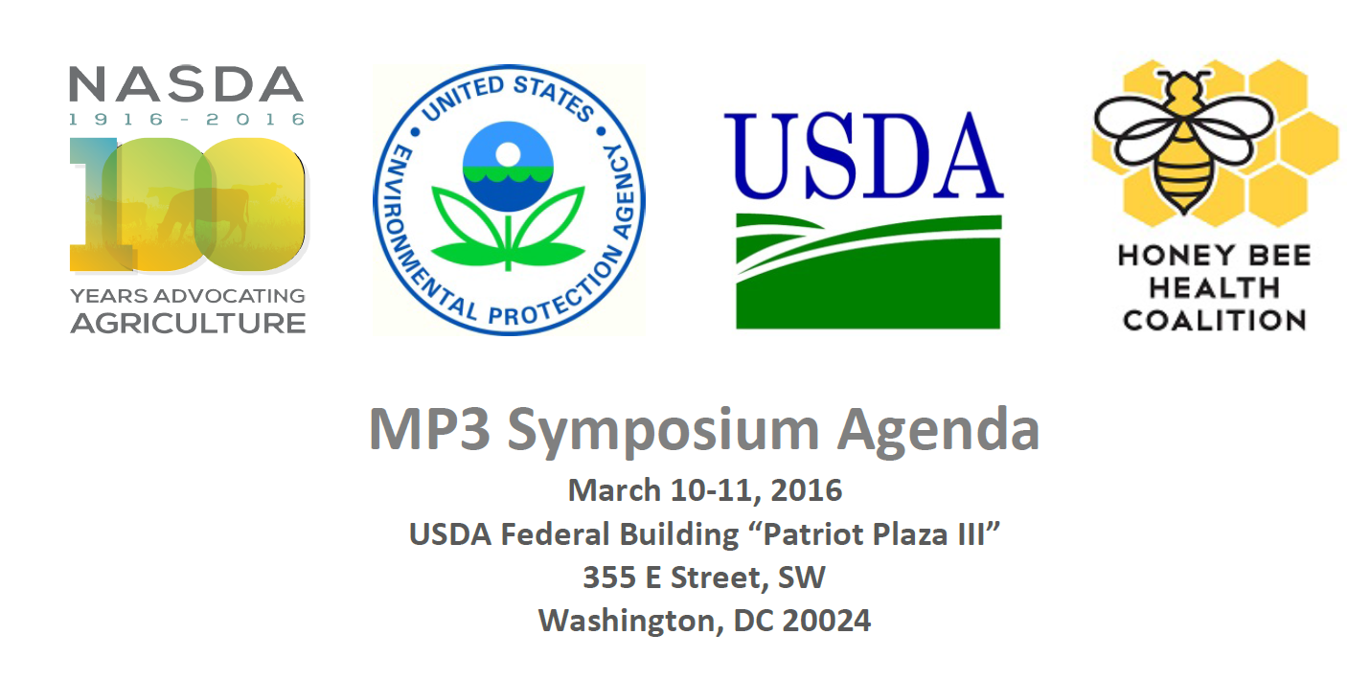
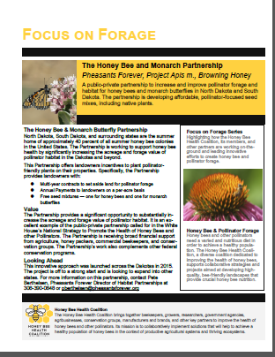
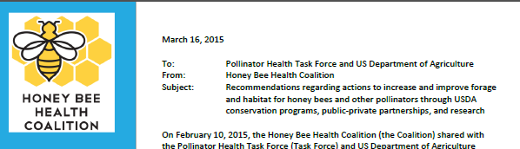
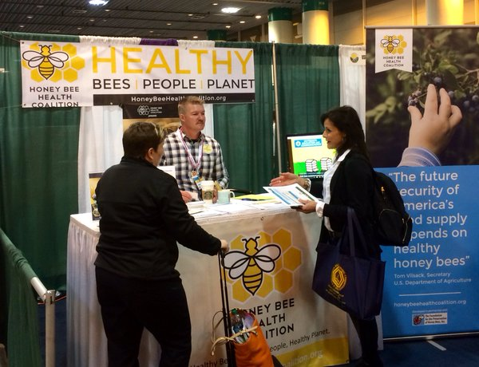
OVERVIEW OF ACHIEVEMENTS
Recent deliverables
Varroacide Screening
Notes:
Bee Healthy Roadmap – established Coalition’s top priorities
Hive management – varroa guide, varroa videos, varroacide screening
Crop pest – MP3 symposium, incident reporting guide, grower and beekeeper roles (can also mention imidacloprid comment)
Forage and nutrition – USDA and task force recommendations
Outreach – Bee Understanding project, farm and beekeeper tradeshows like Commodity Classic, Farm Progress show, Farm Bureau, etc., newsletters, and more
Check out our website for more tools and resources

Slide 18
FORAGE AND NUTRITION
Goal: Ensure honey bees – especially in and around production agriculture – have access to a varied and nutritious diet throughout their lives
Activities:
Providing recommendations to improve and increase forage in USDA conservation programs
Engaged in demonstration projects to get forage on the ground
Conducting beekeeper interviews to identify recommendations for nutrition supplement research and development

Slide 19
CROP PEST CONTROL
Goal: Control crop pests and safeguard pollinator health
Activities
Supporting BMP development, training and adoption, including through development of pollinator best management practices for soybeans and for pesticide applicators
Supporting State MP3 conversations by convening a national symposium
Developed an incident reporting guide for incidental pesticide exposure

Slide 20
HIVE MANAGEMENT
Goal: Put the best available tools, techniques, and technologies in the hands of beekeepers so they can better manage their hives
Activities:
Developed a guide to Varroa control methods and accompanying educational videos
Research and testing into new varroacides
Support of Bee Informed Partnership’s Tech Transfer Teams

Slide 21
Outreach, Education, and Collaboration
Goal: Work together to improve honey bee health, develop outreach materials; and develop future research and demonstration projects.
Activities:
  Promoting public-private education, communications, outreach, and collaboration across diverse stakeholders, through experiential learning and other platforms
  Develop outreach materials and opportunities

Slide 22

Bee Integrated Demonstration Project
Will demonstrate how honey bee health can be improved using a portfolio of tools together in the same agricultural landscape to address multiple factors.
                Forage establishment
                Varroa monitoring and treatment
                Crop pest management BMPs
                Outreach and education

Slide 23
IN SUMMARY
A Collaborative network of diverse, private and public sector stakeholders to unpack these complex issues and find solutions to honey bee health
The Honey Bee Health Coalition is engaging a variety of public-private partners throughout agriculture, research, government, and conservation to promote multi-factor solutions for honey bee health.

Slide 24

MORE INFORMATION
www.honeybeehealthcoalition.org
mmulica@keystone.org
‘To go fast, go alone. To go far, go together.’
- African Proverb

