Slide 1
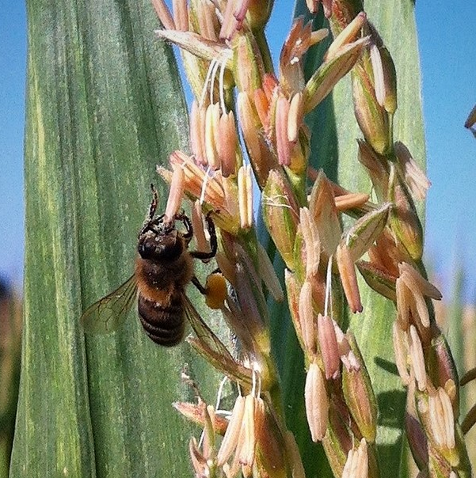
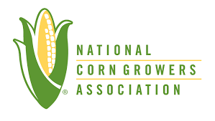
Best Management Practices (BMPs)
for Pollinator Protection in Corn
Guidance for Growers and Crop Consultants
Notes:
The National Corn Growers Association, in partnership with the Honey Bee Health Coalition, developed these BMPs in 2019 to safeguard pollinators in and around corn production.

Slide 2
We all rely on honey bees
We all rely on honey bees
Honey bees are a key component of sustainable agriculture, healthy diets, the global food supply, and the economy.

Slide 3
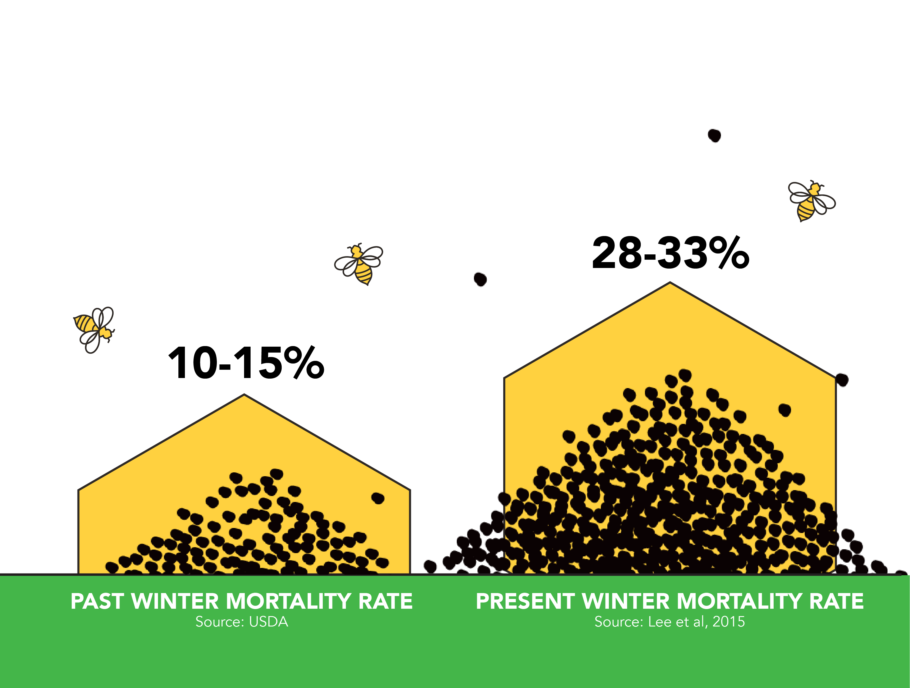
The challenge
Compared to historical rates, more honey bee colonies die each winter and each year.

Slide 4
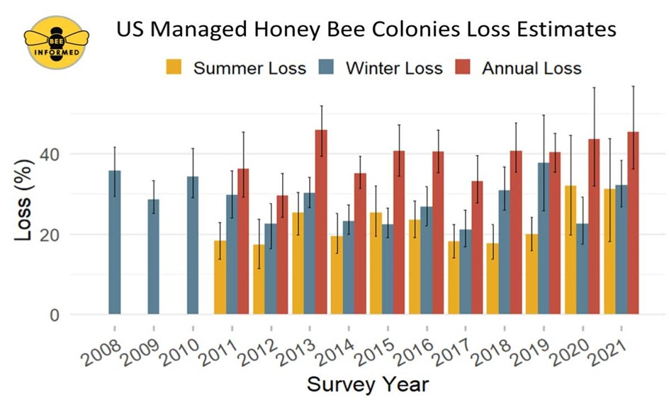
above average Colony losses
Beekeepers must replenish colonies by splitting their hives or purchasing new bees.
Notes:
Winter and annual losses (yellow and orange) have been far exceeding acceptable loss rates (grey).

Slide 5
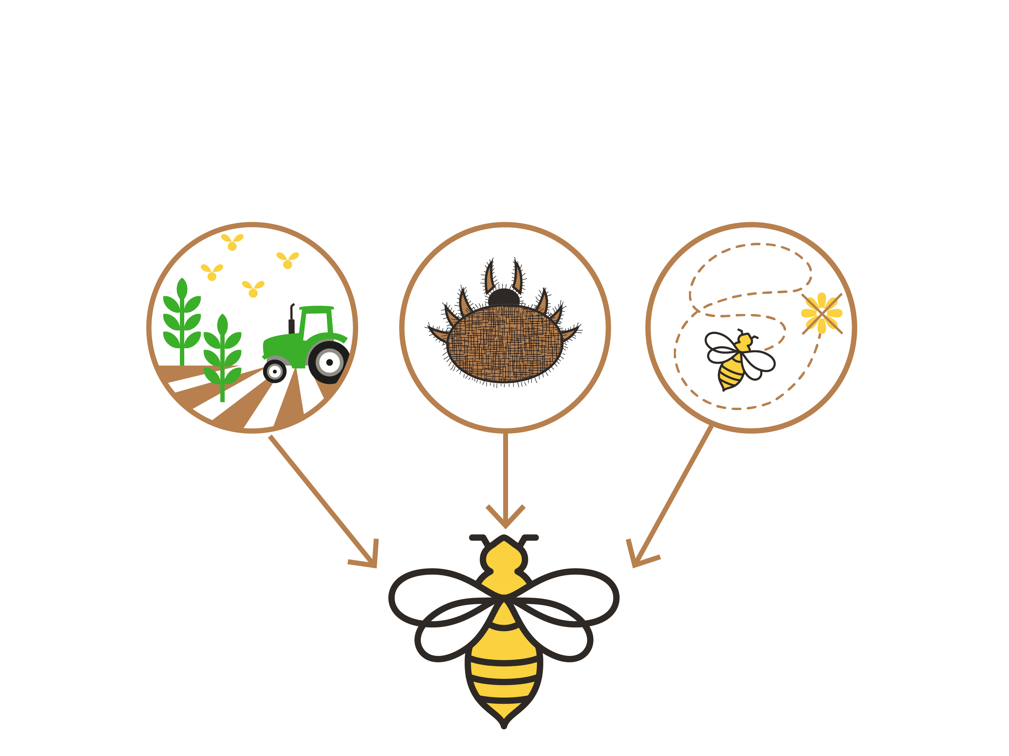
STRESS factors
Impacts on bee health have been linked to a variety of interacting factors, including:
Pesticide
Exposure
Pests & Disease
Poor Forage & Nutrition
Notes:
The 3 P’s speaker notes:
Pests and Disease
Honey bees are under attack. Varroa mites, nosema, and viruses are killing honey bee colonies
Poor Forage & Nutrition
Lack of a varied diet – due to declining wild spaces and increased monocultures – have led to malnutrition.
Pesticide Exposure
Use of pesticide and other crop protection products can incidentally expose and harm bees. Naturally occurring and other industrial toxins in the environment also may impact bee health

Slide 6
EVERYONE in ag haS a role to play
Beekeepers are:
Improving their management of hive pests & diseases
Growers and landowners are:
Planting bee forage and letting flowering plants grow on marginal crop lands
Improving crop pest management practices to reduce pesticide exposure on bees
Consultants and applicators are:
Scouting crops for pest presence and severity, potential economic damage, and presence of bees (and other beneficial insects)
Recommending pesticides as appropriate to the pest, crop, and local environment (including bees)
Ensuring safe and lawful application of pesticides
Notes:
Need to add graphics

Slide 7
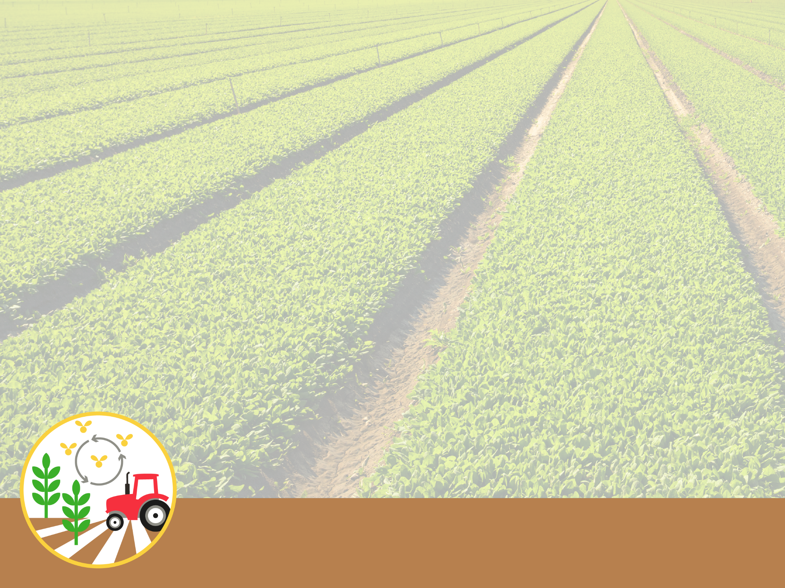
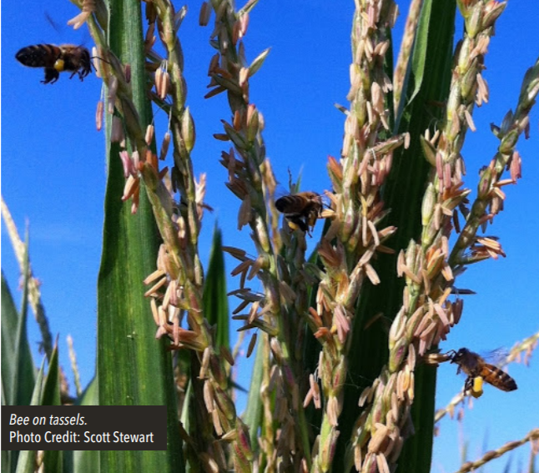
BMPs for Protecting Bees
COMMUNICATE and coordinate with local beekeepers
Help beekeepers strategically place hives around your fields and find out where nearby hives will be located.
Create an agreement with beekeepers to guide interactions based on hive locations and risks to bees from potential future pesticide applications.
GPS- and GIS-based apps and registries, such as FieldWatch, can help.
For more details, go to https://ncga.com/key-issues/other-topics/pollinators

Slide 8
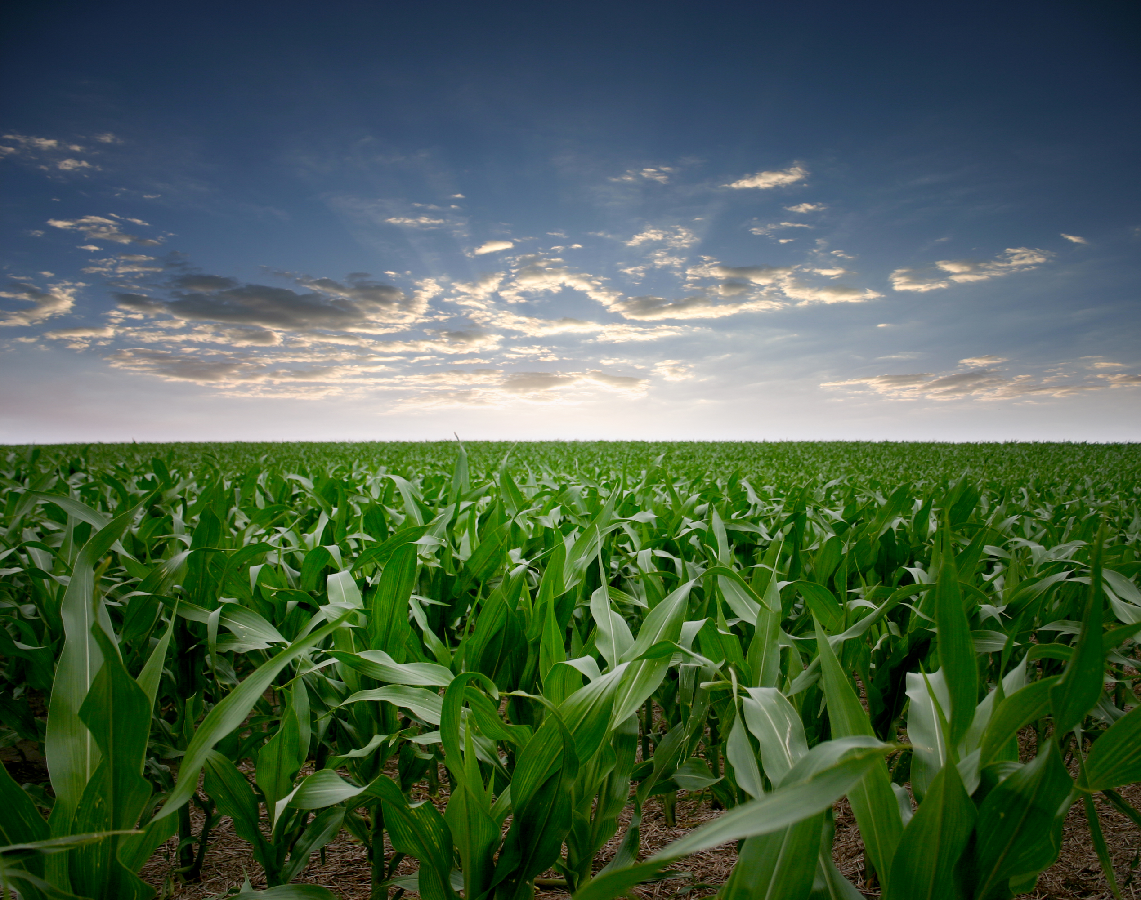
BMPs for Protecting Bees
MINIMIZE pesticide exposure from dust & drift
Follow all label instructions and pay special attention to weather and use field buffers to avoid pesticide drift.
Use IPM to reduce the need for pesticides.
Use a seed lubricant to minimize dust from treated seeds.
Clean up and dispose of treated seeds, insecticides, and their containers properly.
Choose products with low toxicity to bees and short residual toxicity time.
Delay pesticide applications until evening when bees and other pollinators have stopped flying for the day.
For more details, go to https://ncga.com/key-issues/other-topics/pollinators

Slide 9
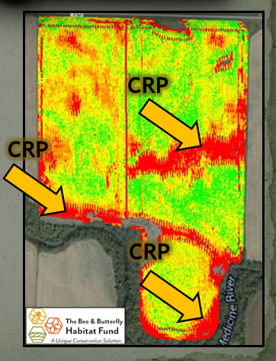
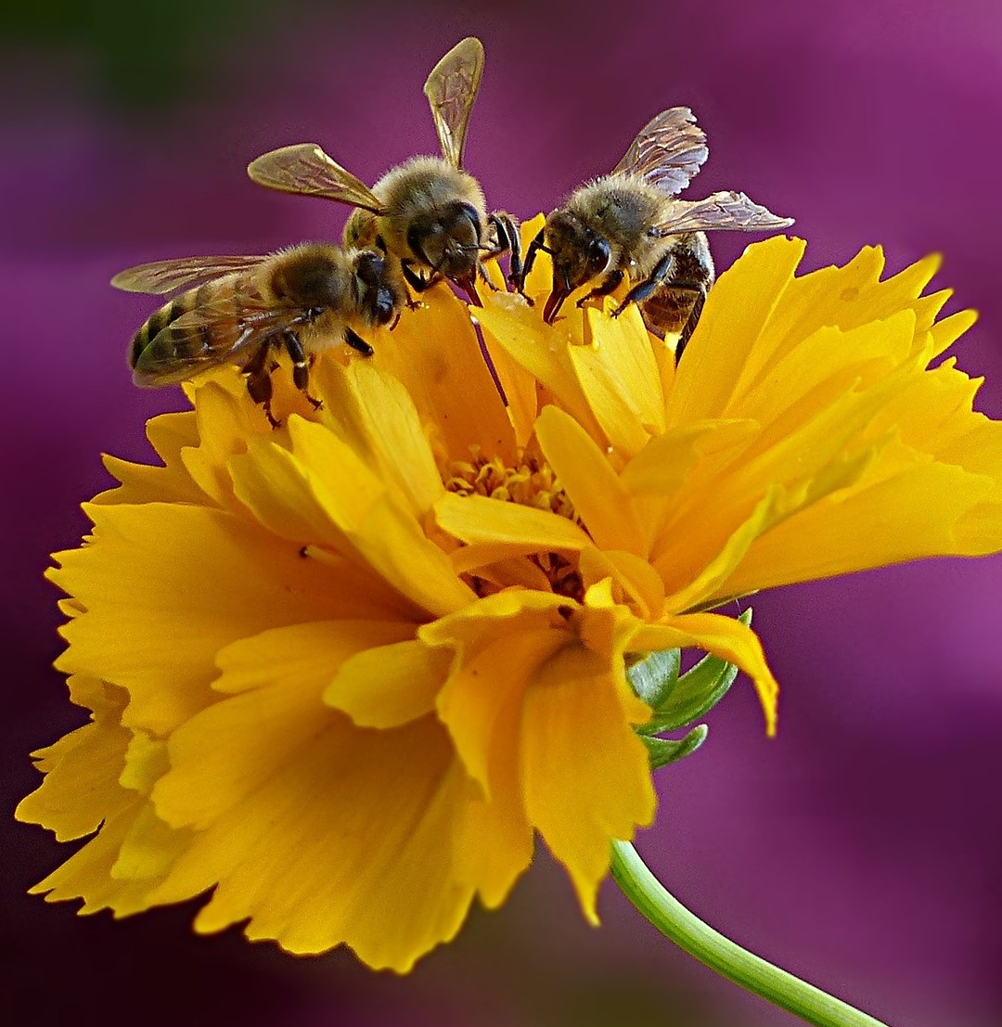
BMPs for Protecting Bees
PROVIDE safe habitat on fallow and marginal crop land
Grow flowering plants, trees, and shrubs in non-crop areas such as field borders, buffer strips, roadways, railways, and waterways.
Conservation programs can help by offering cost-sharing, seeds, technical support, and other incentives for establishing pollinator habitat and restoring native plants.
Avoid tilling and mowing non-crop areas.
Avoid spraying non-crop areas and water sources with insecticides.
For more details, go to https://ncga.com/key-issues/other-topics/pollinators

Slide 10
Pollinator protection checklist
Throughout the growing season
Establish and maintain open communication with local beekeepers
Follow IPM practices
Seek most effective product with lowest toxicity to bees
Read and follow the label
Minimize pesticide exposure to bees from dust and drift
Provide safe habitat in non-crop areas

Slide 11
FOR MORE INFORMATION
Best Practices for
Pollinator Protection in Field Corn:
https://dt176nijwh14e.cloudfront.net/file/133/HBHC_Corn_030119.pdf

Slide 12
HOW THE BMPs WERE DEVELOPED
Technical Committee
Nick Seiter, University of Illinois (Lead Author)
Kelvin Adee, American Honey Producers Association
Paul Bertels, Farmgate Insights
Dave Epstein, U.S. Department of Agriculture
Nathan Fields, National Corn Growers Association
Jeff Harris, Mississippi State University
Mike Mason, Prairie State Beekeepers Association
Josiah McClellan, United Soybean Board
Robert Sears, Eastern Missouri Beekeepers Association
Tom Steeger, U.S. Environmental Protection Agency
Scott Stewart, University of Tennessee
Adam Varenhorst, South Dakota State University
Jason Weirich, MFA Inc.
Lead author reviewed pollinator protection BMPs for other crops and geographies
Technical committee identified suitable BMPs based on corn pest protection needs and practices
Broader stakeholder group reviewed and provided input
National Corn Growers Association released final BMPs
For more details, go to https://ncga.com/key-issues/other-topics/pollinators

Slide 13
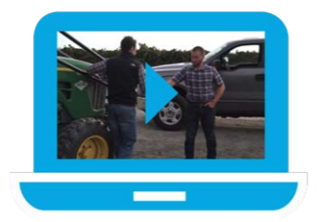
Example VIDEOS
Scene 1: Grower and beekeeper make a plan.
https://www.dropbox.com/sh/ej653q8d1mmzkd1/AACWAWEf9xCF2NSLt2dus9-8a/720p/Honey%20Bee_Scene1_v2_1.mp4?dl=0
Scene 2: Grower and consultant make a plan.
https://www.dropbox.com/sh/ej653q8d1mmzkd1/AAAglVPbeP3kKiuuq6P-Ln6Ca/720p/Honey%20Bee_Scene2_1.mp4?dl=0
Scene 3: Grower and consultant talk about applying treatment.
https://www.dropbox.com/sh/ej653q8d1mmzkd1/AAAiPkX3KvNxTILSEh2iy5Cda/720p/Honey%20Bee_Scene3_1.mp4?dl=0
Scene 4: Grower and beekeeper talk about applying treatment.
https://www.dropbox.com/sh/ej653q8d1mmzkd1/AADa4tw4v2_kXSjrKw6ziJuWa/720p/Honey%20Bee_Scene4_v3_1.mp4?dl=0
For more details, go to https://ncga.com/key-issues/other-topics/pollinators

