Slide 1
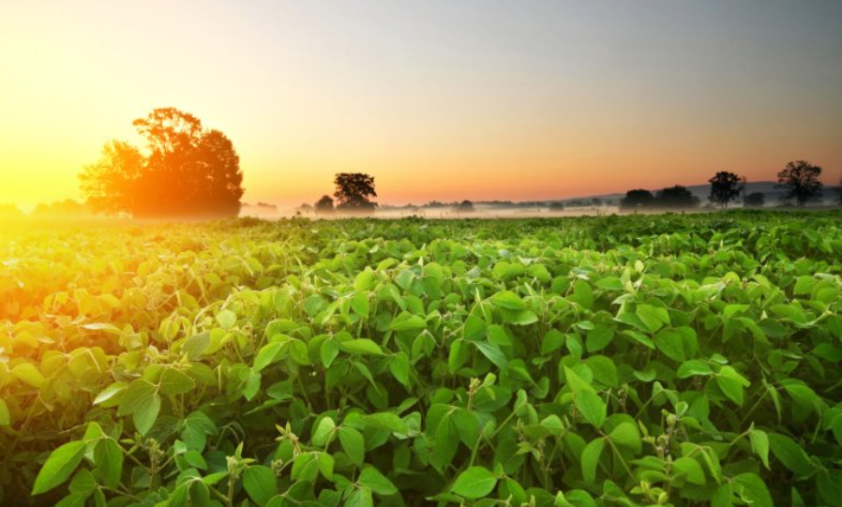
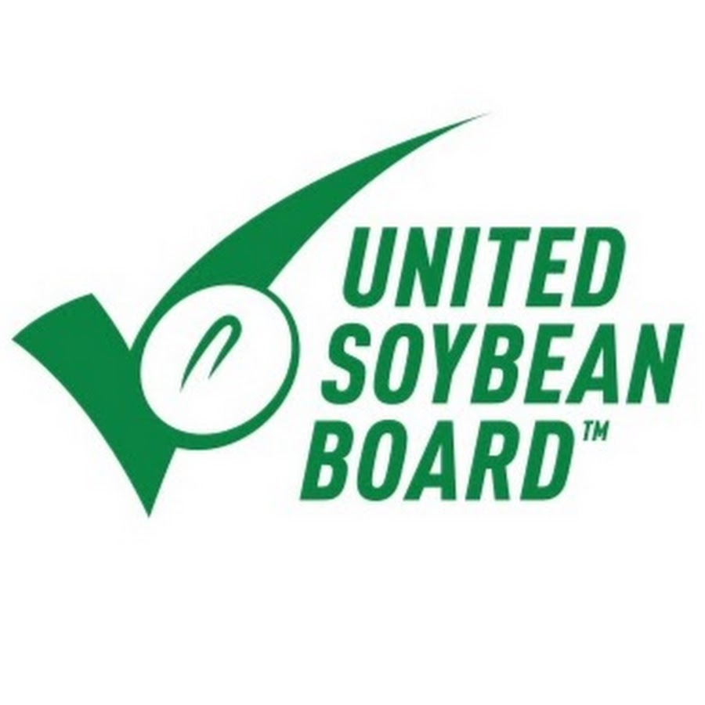
Best Management Practices (BMPs)
for Pollinator Protection in Soybeans
Guidance for Growers and Crop Consultants
Notes:
The United Soybean Board, in partnership with the Honey Bee Health Coalition, developed these BMPs in 2018 to safeguard pollinators in and around corn production.

Slide 2
We all rely on honey bees
We all rely on honey bees
Honey bees are a key component of sustainable agriculture, healthy diets, the global food supply, and the economy.

Slide 3
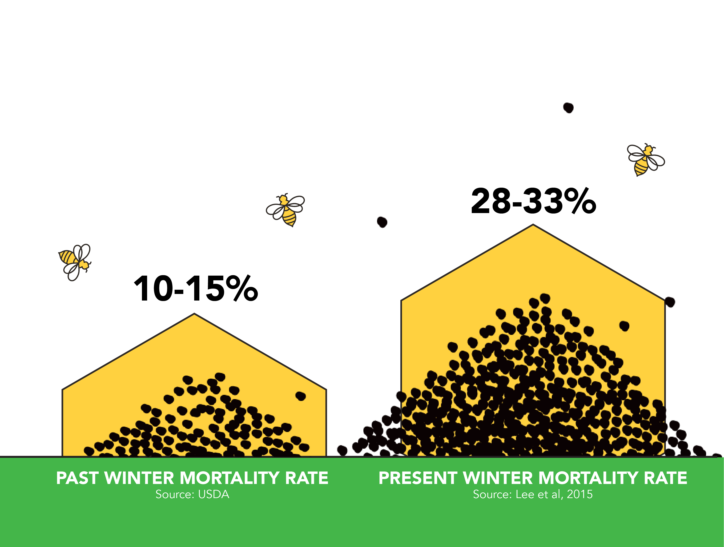
The challenge
Compared to historical rates, more honey bee colonies die each winter and each year.

Slide 4
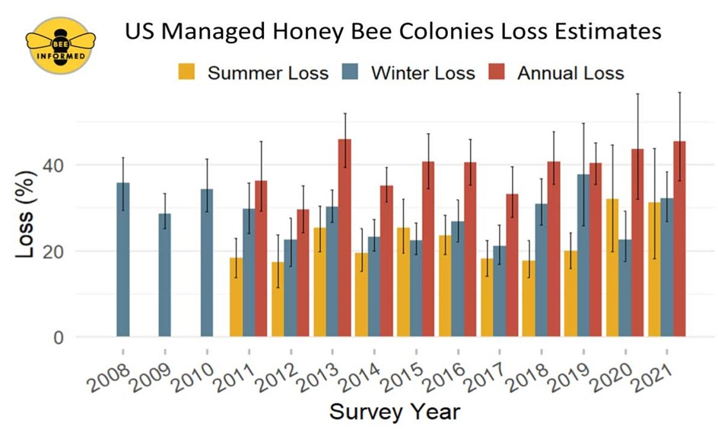
above average Colony losses
Beekeepers must replenish colonies by splitting their hives or purchasing new bees.
Notes:
Winter and annual losses (yellow and orange) have been far exceeding acceptable loss rates (grey).

Slide 5
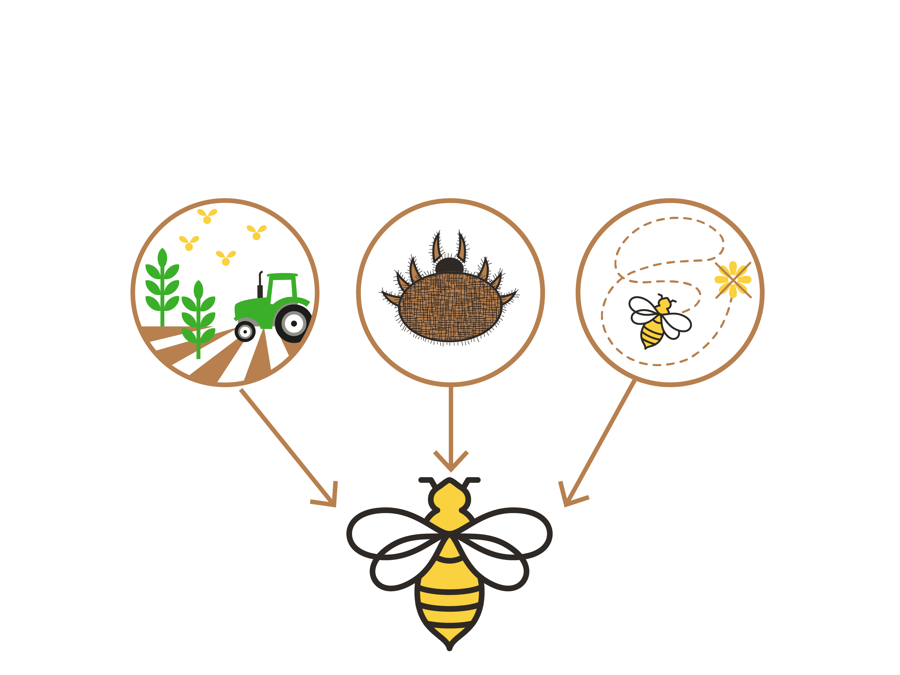
STRESS factors
Impacts on bee health have been linked to a variety of interacting factors, including:
Pesticide
Exposure
Pests & Disease
Poor Forage & Nutrition
Notes:
The 3 P’s speaker notes:
Pests and Disease
Honey bees are under attack. Varroa mites, nosema, and viruses are killing honey bee colonies
Poor Forage & Nutrition
Lack of a varied diet – due to declining wild spaces and increased monocultures – have led to malnutrition.
Pesticide Exposure
Use of pesticide and other crop protection products can incidentally expose and harm bees. Naturally occurring and other industrial toxins in the environment also may impact bee health

Slide 6
EVERYONE in ag has a role to play
Beekeepers are:
Improving their management of hive pests & diseases
Growers and landowners are:
Planting bee forage and letting flowering plants grow on marginal crop lands
Improving crop pest management practices to reduce pesticide exposure on bees
Consultants and applicators are:
Scouting crops for pest presence and severity, potential economic damage, and presence of bees (and other beneficial insects)
Recommending pesticides as appropriate to the pest, crop, and local environment (including bees)
Ensuring safe and lawful application of pesticides
Notes:
Need to add graphics

Slide 7
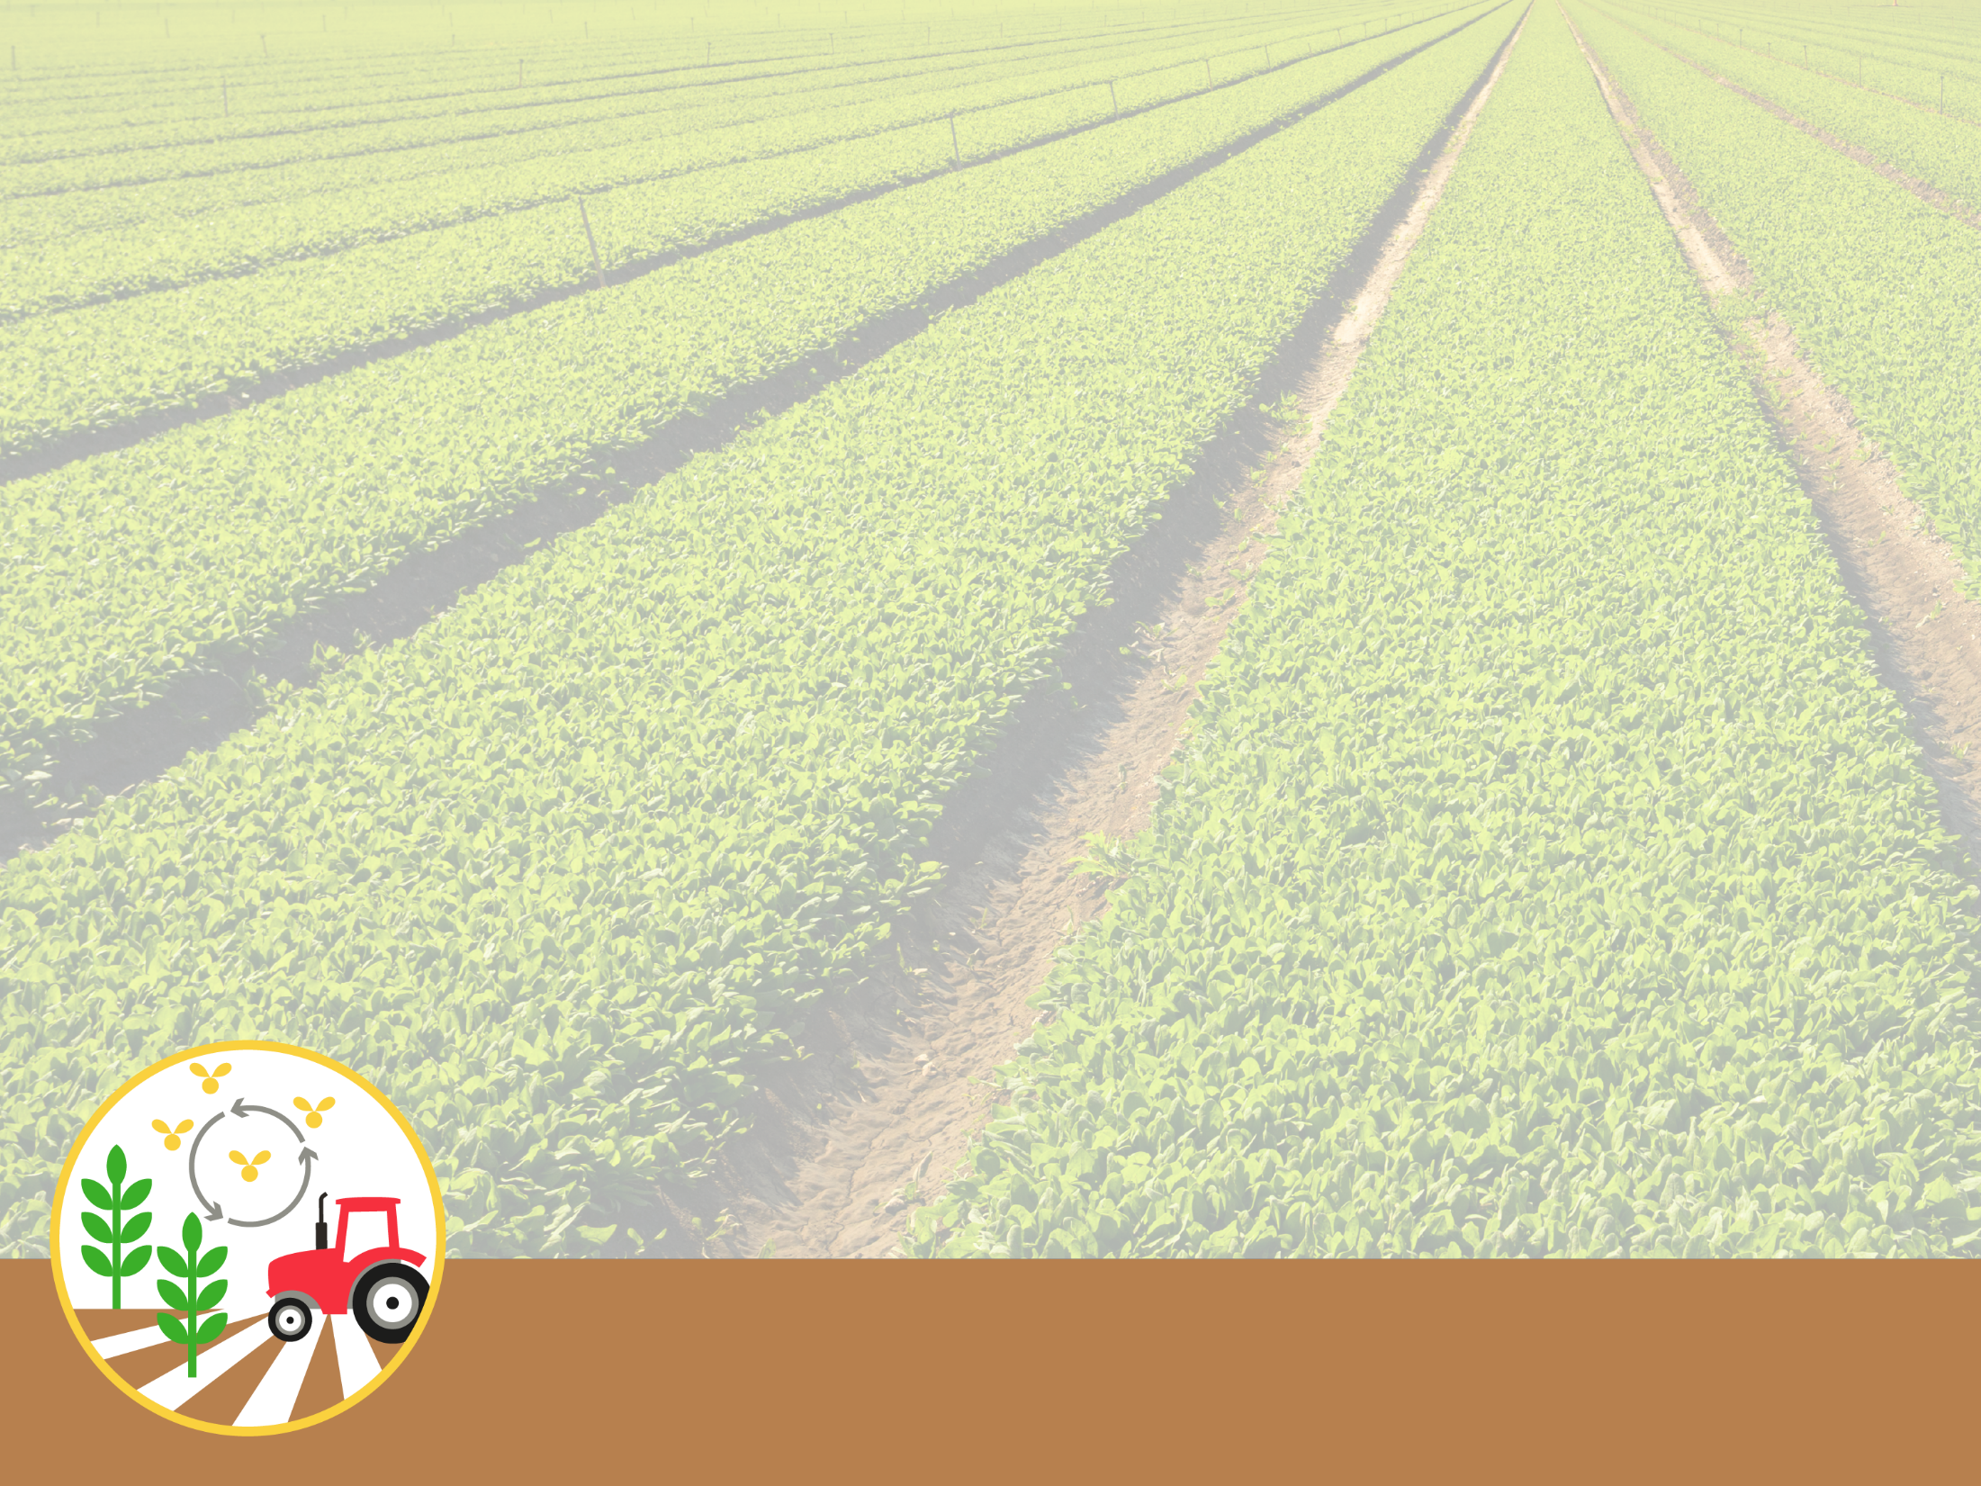
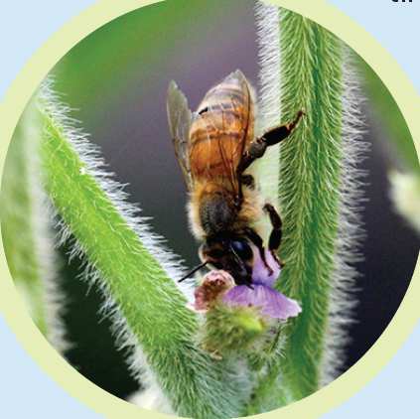
BMPs for Protecting Bees
COMMUNICATE and coordinate with local beekeepers
Help beekeepers strategically place hives around your fields and find out where nearby hives will be located.
Create an agreement with beekeepers to guide interactions based on hive locations and risks to bees from potential future pesticide applications.
GPS- and GIS-based apps and registries, such as FieldWatch, can help.
Bee pollination can increase soybean yields by as much as 18 percent.
For more details, go to
HoneyBeeHealthCoalition.org/resources/soybean-best-management-practices/
Notes:
References for 18 percent possible yield bump:
Chiari WC, et al. (2005) Pollination of soybean (Glycine max L. Merril) by honeybees (Apis mellifera L.). Braz Arch Biol Techn 48(1):31-36. 7.
Erickson EH, Berger GA, Shannon JG, & Robins JM (1978) Honey Bee Hymenoptera-Apidae Pollination Increases Soybean Yields in Mississippi Delta Region of Arkansas and Missouri. J Econ Entomol 71(4):601-603. 8.
Milfont MD, Rocha EEM, Lima AON, & Freitas BM (2013) Higher soybean production using honeybee and wild pollinators, a sustainable alternative to pesticides and autopollination. Environ Chem Lett 11(4):335-341

Slide 8
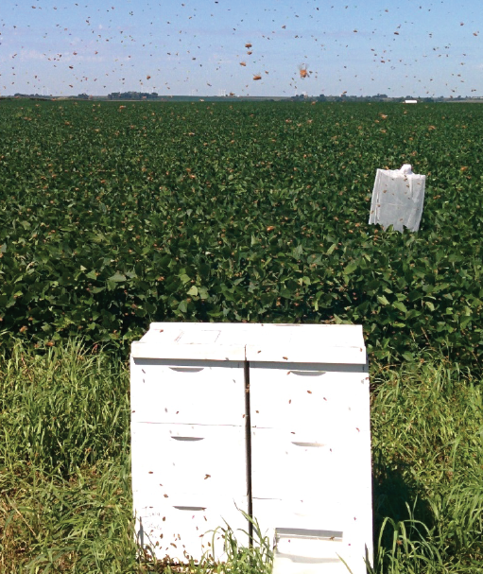
BMPs for Protecting Bees
MINIMIZE pesticide exposure from dust & drift
Always follow the label and use IPM to reduce the need for pesticides.
Use a seed lubricant to minimize dust from treated seeds.
When possible, avoid insecticides while the crop is flowering. Choose products with low toxicity to bees and short residual toxicity time.
Clean up and dispose of treated seeds, insecticides, and their containers properly.
Check weather conditions and use appropriate equipment and field buffers to avoid pesticide drift.
Delay pesticide applications until evening when bees and other pollinators have stopped flying for the day.
For more details, go to
HoneyBeeHealthCoalition.org/resources/soybean-best-management-practices/

Slide 9
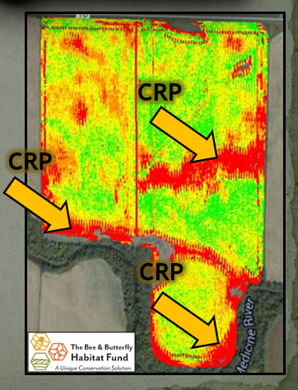
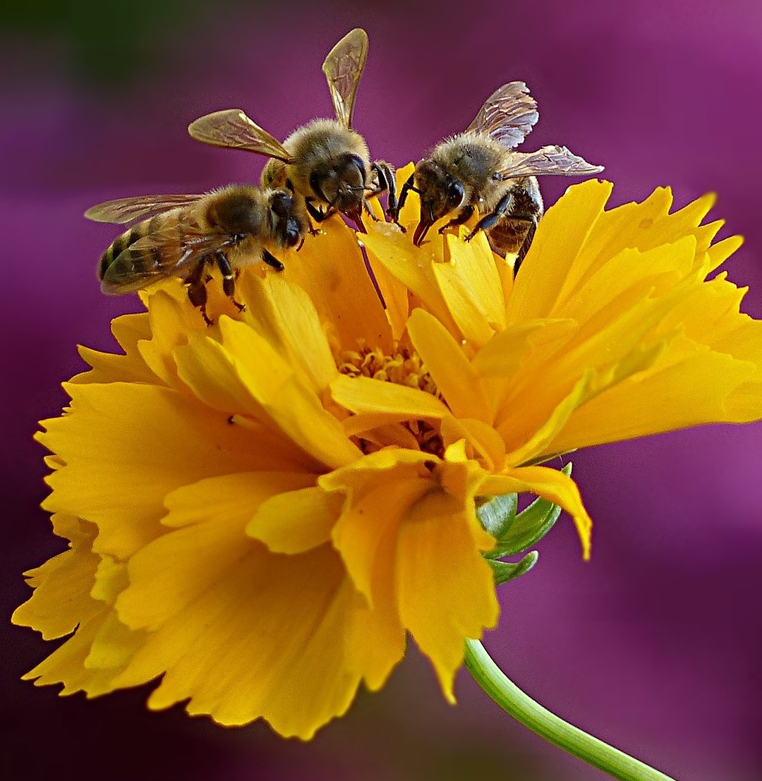
BMPs for Protecting Bees
PROVIDE safe habitat on fallow or marginal crop land
Grow flowering plants, trees, and shrubs in non-crop areas such as field borders, buffer strips, roadways, railways, and waterways.
Conservation programs can help by offering cost-sharing, seeds, technical support, and other incentives for establishing pollinator habitat and restoring native plants.
Avoid tilling and mowing non-crop areas.
Avoid spraying non-crop areas and water sources with insecticides.
For more details, go to
HoneyBeeHealthCoalition.org/resources/soybean-best-management-practices/

Slide 10
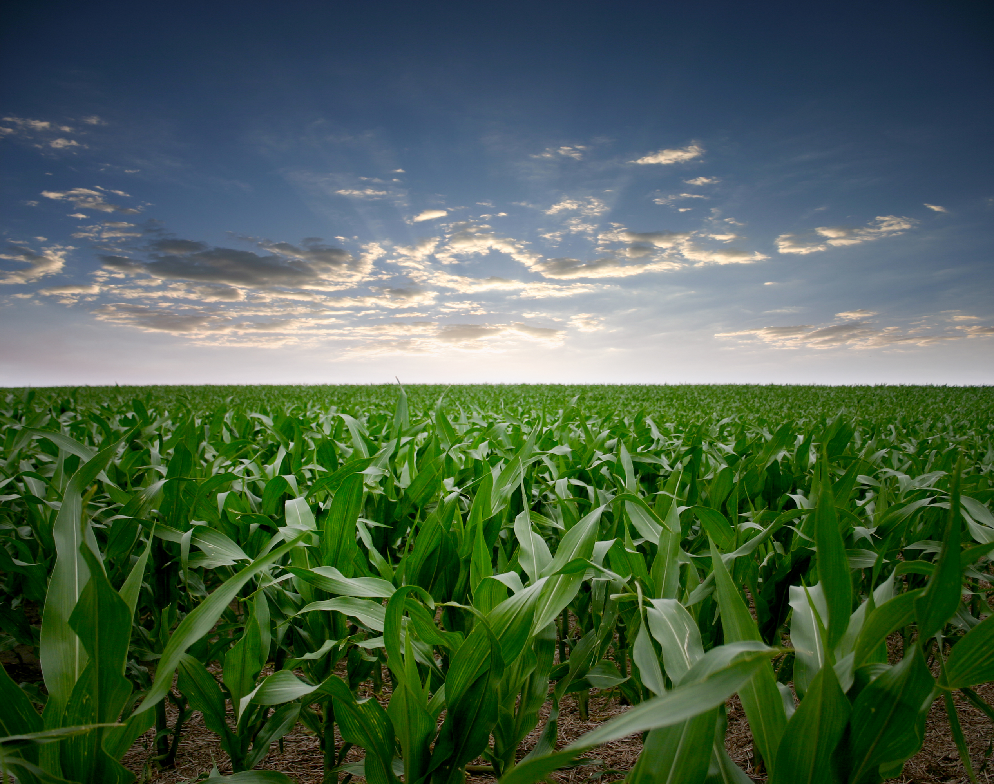
Pollinator protection checklist
Throughout the GROWING season
Establish and maintain open communication with local beekeepers
Follow IPM practices
Seek most effective product with lowest toxicity to bees
Read and follow the label
Minimize pesticide exposure to bees from dust and drift
Provide safe habitat in non-crop areas

Slide 11
FOR MORE INFORMATION
Best Practices for
Pollinator Protection in
Soybeans:
HoneyBeeHealthCoalition.org/resources/soybean-best-management-practices/

Slide 12
HOW THE BMPs WERE DEVELOPED
Technical Committee
Adam Dolezal, University of Illinois at Urbana-Champaign (Lead Author)
Shawn Conley, University of Wisconsin
Dave Epstein, U.S. Department of Agriculture
George Hansen, American Beekeeping Federation
Chris Hiatt, American Honey Producers Association
Rich Joost, United Soybean Board
Chad Lee, University of Kentucky
Matt O’Neal, Iowa State University
Jeremy Ross, University of Arkansas
Robert Sears, Eastern Missouri Beekeepers Association
Scott Stewart, University of Tennessee
Kelly Tilmon, Ohio State University
Bill Wiebold, University of Missouri
Lead author reviewed pollinator protection BMPs for other crops and geographies
Technical committee identified suitable BMPs based on soybean pest protection needs and practices
Broader stakeholder group reviewed and provided input
United Soybean Board released BMPs
For more details, go to
HoneyBeeHealthCoalition.org/resources/soybean-best-management-practices/

Slide 13
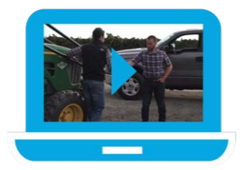
Example VIDEOS
Scene 1: Grower and beekeeper make a plan.
https://www.dropbox.com/sh/ej653q8d1mmzkd1/AACWAWEf9xCF2NSLt2dus9-8a/720p/Honey%20Bee_Scene1_v2_1.mp4?dl=0
Scene 2: Grower and consultant make a plan.
https://www.dropbox.com/sh/ej653q8d1mmzkd1/AAAglVPbeP3kKiuuq6P-Ln6Ca/720p/Honey%20Bee_Scene2_1.mp4?dl=0
Scene 3: Grower and consultant talk about applying treatment.
https://www.dropbox.com/sh/ej653q8d1mmzkd1/AAAiPkX3KvNxTILSEh2iy5Cda/720p/Honey%20Bee_Scene3_1.mp4?dl=0
Scene 4: Grower and beekeeper talk about applying treatment.
https://www.dropbox.com/sh/ej653q8d1mmzkd1/AADa4tw4v2_kXSjrKw6ziJuWa/720p/Honey%20Bee_Scene4_v3_1.mp4?dl=0
For more details, go to
HoneyBeeHealthCoalition.org/resources/soybean-best-management-practices/

